Slide 1

Growing As Children of Light
Notes:
This graphic came from Jason Hardin. I am certain have I have used notes from Mark Copeland’s EO series, Randy Yerby, Aaron Fleenor and other in making these powerpoints. Further, images have been used from the internet that remain property of their owners. This can not be sold or used commercially. It can only be used for classroom (Bible class) purposes.

Slide 2

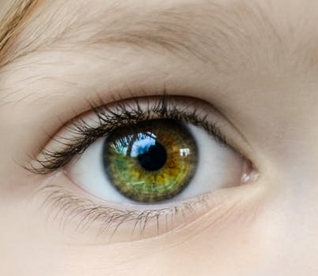
Eyeing Second Peter
Building On God’s Promises
Escaping the Corruption in the World
Partaking of the Divine Nature
Week 5:Virtue and Knowledge

Slide 3
Memory Passage: 2 Peter 1:3-4
According as his divine power hath given unto us all things that pertain unto life and godliness,
through the knowledge of him that hath called us to glory and virtue:
Whereby are given unto us exceeding great and precious promises:
that by these ye might be partakers of the divine nature,
having escaped the corruption that is in the world through lust.

Slide 4
Remembering Second Peter
Blindness and Myopia Control
Eyes Full of Adultery
Twinkling of an Eye
Holiness – Heresy – Hope
Cultivate Christian Character
Condemnation of false teachers
Confidence in Christ’s return
Read 10X, 10 Classes, Mechanism, Memory verse

Slide 5

Eyeing Second Peter
Eyeing Second Peter
Weekly study plan:
Read 2 Peter once a week
Work on the memory verse by reading it carefully aloud at least eleven times this week
Any study on next weeks topic in the text from next week’s topic: Self-control

Slide 6
Introduction:
Growing in the knowledge of Jesus Christ requires developing a Christ-like character, partaking of the divine nature (holiness).
This requires all diligence to develop seven “graces”, in our lives, in conjunction with each other.
2 Peter 1:5-10 ⁵ And beside this, giving all diligence, add to your faith virtue; and to virtue knowledge;⁶ And to knowledge temperance; and to temperance patience; and to patience godliness;⁷ And to godliness brotherly kindness; and to brotherly kindness charity.⁸ For if these things be in you, and abound, they make you that ye shall neither be barren nor unfruitful in the knowledge of our Lord Jesus Christ.⁹ But he that lacketh these things is blind, and cannot see afar off, and hath forgotten that he was purged from his old sins.¹⁰ Wherefore the rather, brethren, give diligence to make your calling and election sure: for if ye do these things, ye shall never fall:

Slide 7
Introduction:
Overview of 2 Peter and graces
Escaping corruption in the world through lust
Diligence
Build on “faith”.
Faith is the power that causes this growth.
We must add to our faith, “virtue”
“add” – epichoregeo – reveals that these two, faith and virtue, must work together.

Slide 8
Myopia(Cannot see in distance) and Blindness Control
Striving For Excellence
VIRTUE
DefiningVirtue
Demands of Virtue
Developing of Virtue
Dilemma of Virtue
Increasing In Knowledge
Defining Knowledge
Demands of Knowledge
Developing Knowledge
Dangers of Knowledge
Application: Virtue and Knowledge

Slide 9

Defining Virtue
Virtue refers to mastery in a specific field, an excellence in achievement eg a virtuoso is a highly accomplished musician
It has been translated and explained differently.
Value is knowing what is right. Virtue is doing what’s right.
It is a people acting to a higher standard than mere instinct.
Foundation of character
In Greek, the word for virtue is arete, which is translated as valor, excellence, moral excellence, vigor, goodness, courage, or praise

Slide 10
Defining Virtue
Rarely used in the New Testament.
Philippians 4:8 (ESV) Finally, brothers, whatever is true, whatever is honorable, whatever is just, whatever is pure, whatever is lovely, whatever is commendable, if there is any excellence, if there is anything worthy of praise, think about these things.
I Peter 2:9 (ESV) But you are a chosen race, a royal priesthood, a holy nation, a people for his own possession, that you may proclaim the excellencies of him who called you out of darkness into his marvelous light. 10 Once you were not a people, but now you are God's people; once you had not received mercy, but now you have received mercy.
2 Peter 1

Slide 11

Defining Virtue
Do not be slothful in zeal, be fervent in spirit, serve the Lord. Romans 12:11
We too must excel in Christianity. We can’t be satisfied being an entry level
We do so by putting what we know to use
Hebrews 12:12-14 For though by this time you ought to be teachers, you need someone to teach you again the basic principles of the oracles of God. You need milk, not solid food, 13 for everyone who lives on milk is unskilled in the word of righteousness, since he is a child. 14 But solid food is for the mature, for those who have their powers of discernment trained by constant practice to distinguish good from evil.
Our duty as God’s people is to proclaim God’s praises, that is the word for virtue.

Slide 12
The Demand of Virtue
Spiritual Life Demands Virtue
Without virtue faith soon dies.
James 2:26 (ESV) For as the body apart from the spirit is dead, so also faith apart from works is dead.
Accomplishment seems to be connected with action. All of us make mistakes, the successful keep moving and don’t quit because Satan closed down one of the lanes or on ramps of traffic to God’s highway. Not only is love an action word, but so is christian.

Slide 13

The Demand of Virtue
Discipleship Demands Virtue
Matthew 5:48 (ESV) You therefore must be perfect, as your heavenly Father is perfect.
Be Holy …. 1 Peter
See Hebrews 10:12-14, Eph 4:11-16

Slide 14
The Demand of Virtue
Colossians 1:27-29 7 To them God chose to make known how great among the Gentiles are the riches of the glory of this mystery, which is Christ in you, the hope of glory. 28 Him we proclaim, warning everyone and teaching everyone with all wisdom, that we may present everyone mature in Christ. 29 For this I toil, struggling with all his energy that he powerfully works within me.
Without virtue (a strong desire for excellence), especially in our relationship with Christ, our faith will be weak and possibly die altogether!

Slide 15

Developing Virtue
Requires the Word of God
II Timothy 3:16-17
We are therefore encouraged to meditate upon that which contains virtue (as surely the Word does!) - Philippians 4:8
Psalm 1:1-3 Blessed is the man who walks not in the counsel of the wicked, nor stands in the way of sinners, nor sits in the seat of scoffers; 2 but his delight is in the law of the Lord, and on his law he meditates day and night. 3 He is like a tree planted by streams of water that yields its fruit in its season, and its leaf does not wither.In all that he does, he prospers.
See Psalms 19:97-104
Study, meditation, time (day and night)

Slide 16
Developing Virtue
“Sow a thought, reap an action; sow an action, reap a habit; sow a habit, reap a character; sow a character, reap a destiny.” –Charles Reader ; L.B. Spurgeon
Action begins in thought
Bad actions – sin – begins with thought (Mark 7:20-23)
Good actions – virtue — begins with thought as well Think on Virtue (Phil 4:8, 2 Cor 10:3-5)
We have to put our knowledge of what is right into action.
Virtue is not moral mediocrity. “It’s good enough” is not good enough.
Doing the minimum necessary is not virtue
Proverbs 20:11 Even a child makes himself known by his acts, by whether his conduct is pure and upright.

Slide 17
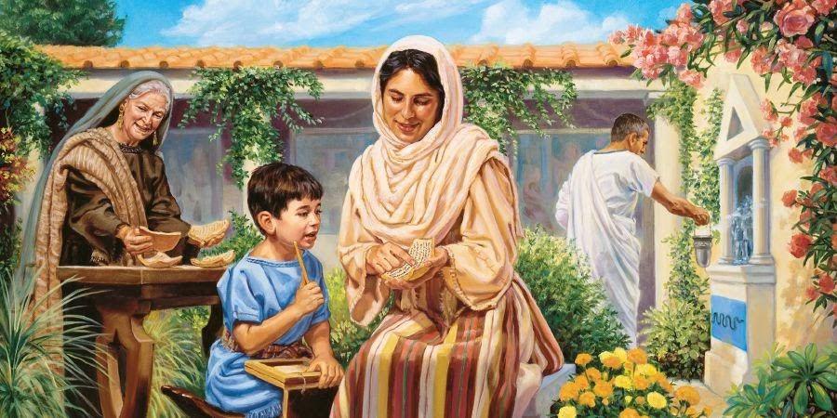
Developing Virtue
By Following Worthy Examples:
(Timothy of GM and mother)
Paul - Philippians 3:12-17 Not that I have already obtained this or am already perfect, but I press on to make it my own, because Christ Jesus has made me his own. 13 Brothers, I do not consider that I have made it my own. But one thing I do: forgetting what lies behind and straining forward to what lies ahead, 14 I press on toward the goal for the prize of the upward call of God in Christ Jesus. 15 Let those of us who are mature think this way, and if in anything you think otherwise, God will reveal that also to you. 16 Only let us hold true to what we have attained.17 Brothers, join in imitating me, and keep your eyes on those who walk according to the example you have in us.

Slide 18
Developing Virtue
By Following Worthy Examples:
Jesus is the Ultimate Example (1 Corinthians 11:1-2 Imitate); Ephesians 4:15-16
Heb 12:1-2 Hebrews 12:1-12 Therefore, since we are surrounded by so great a cloud of witnesses, let us also lay aside every weight, and sin which clings so closely, and let us run with endurance the race that is set before us, 2 looking to Jesus, the founder and perfecter of our faith, who for the joy that was set before him endured the cross, despising the shame, and is seated at the right hand of the throne of God.
Meditate: Philippians 4:8-9 (previous)

Slide 19
Dilemma of Virtue
Paul’s dilemma is between values and virtue - Romans 7
Paul looks at his life and sees difference between what he knows he should be do (that is the things he values) and what he actual does.
Everyone who has struggled against sin recognizes the dilemma. (Snuggle/struggle)
The discord comes from learning God’s law, but acting according to the flesh
Which defines us? The things we know or the things we do?
It is not that we must sin
Virtue is not what we happen to do once in a while.
It is the course of action we take from habit. It is our disposition, what we do without much thought.
But it is not any action, virtue is those habitual right or good actions.
Virtue is the quality of doing what is right and avoiding what is wrong.

Slide 20
Dilemma of Virtue: Snuggle/Struggle Dilemma
Romans 7:14-24 For we know that the law is spiritual, but I am of the flesh, sold under sin. 15 For I do not understand my own actions. For I do not do what I want, but I do the very thing I hate. 16 Now if I do what I do not want, I agree with the law, that it is good. 17 So now it is no longer I who do it, but sin that dwells within me. 18 For I know that nothing good dwells in me, that is, in my flesh. For I have the desire to do what is right, but not the ability to carry it out. 19 For I do not do the good I want, but the evil I do not want is what I keep on doing. 20 Now if I do what I do not want, it is no longer I who do it, but sin that dwells within me. 21 So I find it to be a law that when I want to do right, evil lies close at hand. 22 For I delight in the law of God, in my inner being, 23 but I see in my members another law waging war against the law of my mind and making me captive to the law of sin that dwells in my members. 24 Wretched man that I am! Who will deliver me from this body of death?

Slide 21

Myopia (Nearsighted) and Blindness Control
Increasing In Knowledge
Defining Knowledge
Demands of Knowledge
Developing Knowledge
Dangers of Knowledge
Dangers When Rejecting Knowledge of God

Slide 22
Defining Knowledge
The Knowledge (Epignosis) of Jesus Christ.
The word (epignosis) in this phrase means, “to become thoroughly acquainted with, know thoroughly, know accurately, know well.”
This word conveys the normal idea of knowledge: "awareness through study and experience"

Slide 23
Defining Knowledge
This knowledge is understanding the will of God and the way of salvation through Jesus Christ. See Luke 1:75-77, Phil 3:7-8, Prov 1:7
John 8:31-32 Jesus said to the Jews who had believed him, “If you abide in my word, you are truly my disciples, 32 and you will know the truth, and the truth will set you free.
Facts, know, depths of knowledge (experience and time)

Slide 24
The Demand of Knowledge
God Demands His People Have Knowledge
Deuteronomy 6:5-9 You shall love the Lord your God with all your heart and with all your soul and with all your might. 6 And these words that I command you today shall be on your heart. 7 You shall teach them diligently to your children, and shall talk of them when you sit in your house, and when you walk by the way, and when you lie down, and when you rise. 8 You shall bind them as a sign on your hand, and they shall be as frontlets between your eyes. 9 You shall write them on the doorposts of your house and on your gates
See also Jer 31:31-34, Col 1:9-14

Slide 25

The Demand of Knowledge
God Is Displeased With a Lack of Knowledge.
Romans 10:1-3 Brothers, my heart's desire and prayer to God for them is that they may be saved. 2 For I bear them witness that they have a zeal for God, but not according to knowledge. 3 For, being ignorant of the righteousness of God, and seeking to establish their own, they did not submit to God's righteousness. 4 For Christ is the end of the law for righteousness to everyone who believes.
God is displeased with a lack of knowledge Hosea 6:4-6, Hosea 4:1-7, 2 Thess 1:5-9
Without knowledge, all the sincerity and zeal in the world is vain.

Slide 26
How Do We Develop Knowledge?
The Proper Source
Jesus – Colossians 2:1-3
Scriptures – Old and New Testaments
2 Timothy 3:14-17 14 But as for you, continue in what you have learned and have firmly believed, knowing from whom you learned it 15 and how from childhood you have been acquainted with the sacred writings, which are able to make you wise for salvation through faith in Christ Jesus. 16 All Scripture is breathed out by God and profitable for teaching, for reproof, for correction, and for training in righteousness, 17 that the man of God may be complete, equipped for every good work
Romans 15:4 For whatever was written in former days was written for our instruction, that through endurance and through the encouragement of the Scriptures we might have hope.
The knowledge which we are to add to our faith and virtue is found only in the pages of God's Word!

Slide 27
How Do We Develop Knowledge?
The Search for Knowledge Requires….
Proverbs 2:4-7 4 if you seek it like silver and search for it as for hidden treasures, 5 then you will understand the fear of the Lord and find the knowledge of God. 6 For the Lord gives wisdom; from his mouth come knowledge and understanding;7 he stores up sound wisdom for the upright; he is a shield to those who walk in integrity
See also 1 Peter 2;2, Prov 8:10-11, Prov 12:1

Slide 28

How Do We Develop Knowledge?
Do we demonstrate that acquiring knowledge of God's Word is a priority?
If one is diligent in their study of God's Word, their progress will be evident. Sadly, the reverse is also true.
1 Timothy 4:15-16 Practice these things, immerse yourself in them, so that all may see your progress. 16 Keep a close watch on yourself and on the teaching. Persist in this, for by so doing you will save both yourself and your hearers.

Slide 29

The Danger of Knowledge
Knowledge Can Make One Arrogant.
1 Corinthians 8:1-13, 1 Cor 13:4, James 3:13-18
It can "puff up" rather than "build up" (edify)
"A little learning is a dangerous thing."
Love often restrains knowledge. Romans 14:13-21
There is no virtue in knowledge if it leads to arrogance.
See also Rom 1:28-32 Acts 17:30-31, and John 12:48

Slide 30
Application: Demonstrating Virtue Combating Spiritual Blindness
In Our Personal Lives
Does our daily walk with God suggest we are striving for excellence?
Are we seeking to excel in our relationship with God?
By reading and meditating on His Word daily? In Prayer?
In the dilemma of virtue, do we snuggle or struggle
In service to others
Are demonstrating excellence in sharing the gospel?
Do we reach out in virtue to serve others? (good Samaritan)
Do we strive to do right morally excellent? What hinders? Helps?
Are we seeking to excel in our service to God?
Determining and developing our talents?
Using our abilities in service to God and others?

Slide 31
Demonstrating Virtue: Combating Spiritual Blindness
In Our Bible Studies and Assemblies
Does our involvement at this congregation suggest we are striving for excellence?
Do we utilize opportunities to increase our faith?
Do we encourage others? Do we help others?
Do we practice confession as taught in God’s word?
By attending the assemblies of the church?
By participating in the services, exhorting others before and after?
Do we exercise opportunities to encourage others?

Slide 32
Knowledge: Combating Spiritual Blindness
How well educated am I/we in the Scriptures? Are we growing in knowledge?
What causes us to not grow in knowledge of God’s word?
Failure to provide as much diligence as a secular task might require?
Failure to see the value and give it time needed?
Is there a failure in treating God’s word superficially? Do we meditate onit?
In the age of Google, what do we know?
Challenge: Have you planned/executed a plan to grow in knowledge of God’s word?

Slide 33
Where are you on these scales?
Diligence >>>>>>>>>>>>>>>>>>>>>>Indifference/Apathy
Faith >>>>>>>>>>>>>>>>>>>>>>>>>>>>>>>>>>>>>>>Fear
Moral excellence >>>>>>>>>>>>>>>>>>>>>>> Mediocrity
Struggle w/sin >>>>>>>>>>>>>>>>>>>>>>>> Snuggle Sin
Serve >>>>>>>>>>>>>>>>>>>>>>>>>>>>>>>>> Too Busy
Knowledge >>>>>>>>>>>>>>>>>>>>>>>>>>>>> Ignorance
Deep understanding >>>>>>>>Superficial Understanding
Study/meditation>>>>>>>>>>>>>>>>>>> Other activities

Slide 34


Conclusion:
The Christian who adds virtue and knowledge to their faith does not remain static. Growth!
He or she will not be content with their current level of faith and service. (Gary Henry’s “Intermediate.”)
Like Paul, they will desire to press on -- For they are striving for excellence!

